Slide 1
Overview of R’s Automation Capes
A-G Associates Data Science Best Practices
2/21/2025
Madison Merzke

Slide 2
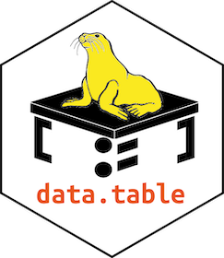
Interacting with Folders and Files
Environmental scans of files and folders, reading properties, etc.
Reading in data from specified files – sometimes many (fread() from data.table package is helpful to save time) – and appending together as appropriate
Reformatting of data and export into other file type or format
Examples:
For OPA, we created a structured list of all files and folders on our server to aid in intentional reorganization of our team’s folders, with charts to visualize organization and maximize consistency and intuitiveness
For SAMHSA, we read in hundreds of public comment files and output their comments into one Excel workbook for analysis
For OPA, we often use list.files() to pipe multiple file names to be read in together into one data frame using map_dfr() and a read-in function
Notes:
list.files function - RDocumentation

Slide 3
Interacting with the Internet
Pulling data into R (from website, via API, etc.)
Could do this with Monday.com I think (definitely with Python)
E.g., with REDCap (Research Electronic Data Capture), a secure, web-based application designed for data collection and management in research studies, widely used in academic, non-profit, and government organizations for its robust features and compliance with various regulations, including HIPAA, GDPR, and 21 CFR Part 11
Maybe also can grab LinkedIn data via API?
Publishing or updating data (to website, via API, etc.)
Sending email (e.g., automated weekly report updated with new data)
Posting on Mastodon or BlueSky via APIs (see hyperlinks for specific packages)
Publishing books/reports, websites, blogs, science and technical articles, etc. (see packages such as bookdown, blogdown, distill, etc.)

Slide 4
Interacting with Databases
We don’t do this much right now, but likely will more as our projects mature and we get more work
Packages such as DBI and RSQLite facilitate database management and interaction, allowing seamless data import/export from SQL databases

Slide 5

Interacting with Microsoft Products
“Make corporate reporting with minimum hassle” with officer
The officer package lets R users manipulate Word (.docx) and PowerPoint (*.pptx) documents. In short, one can add images, tables and text into documents from R. An initial document can be provided; contents, styles and properties of the original document will then be available.
RStudio itself can knit various types of files as well, including PPT, Word, PDF, etc., if you have the more updated version (some clients don’t, necessitating we use officer for them)
Example: For OPA, we use officer in R to output 60+ slides of DEOCS service data tables and graphs on a biweekly cadence during the annual fielding period

Slide 6

Iterative/Functional Programming
Running a code/process multiple times with variable inputs that control/tailor the outputs – within R codes, the purrr package is amazing for this and we use it often in OPA work
Can also schedule R scripts to run automatically at a specified cadence

Slide 7
Combining Approaches
Mix and match automation strategies and tools as needed within R to build your ideal process!
Examples:
Automate toxicology report data collection via reading in hundreds of consistently formatted reports, reformatting as needed in R, and pushing to REDCap via API
Write an R code to pull updated data from CDC via API, run analytics, and email report with visualizations to stakeholders
Output tailored data request letters and lists for each county in a state
See more examples here

Slide 8
Considerations for Client Work
Data security and privacy
Limitations of client technology
Integrate quality control checkpoints into automated processes

Slide 9
Automation: What’s Next?
Our goals for this year include expanding our automation capes into Python, as well as using Git/Github
We want to emphasize our automation capes in our external portfolio/repository, adding metrics when possible
How can you integrate automation into your IDP and into your project for the repository?

Slide 10
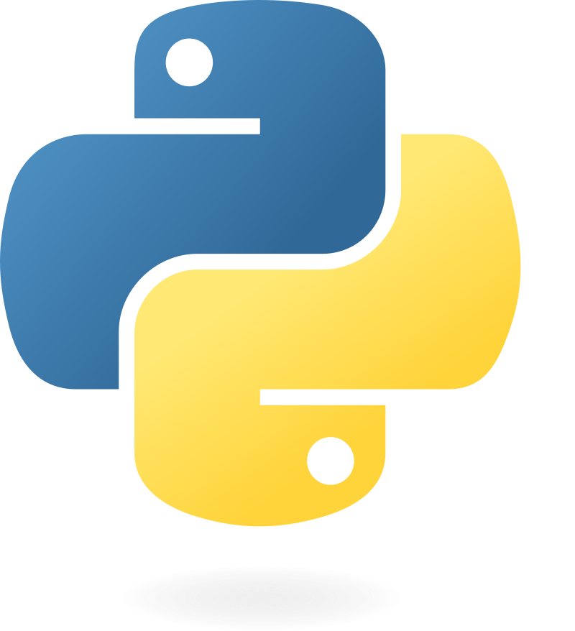
Overview of Python’s
Automation Capes

Slide 11
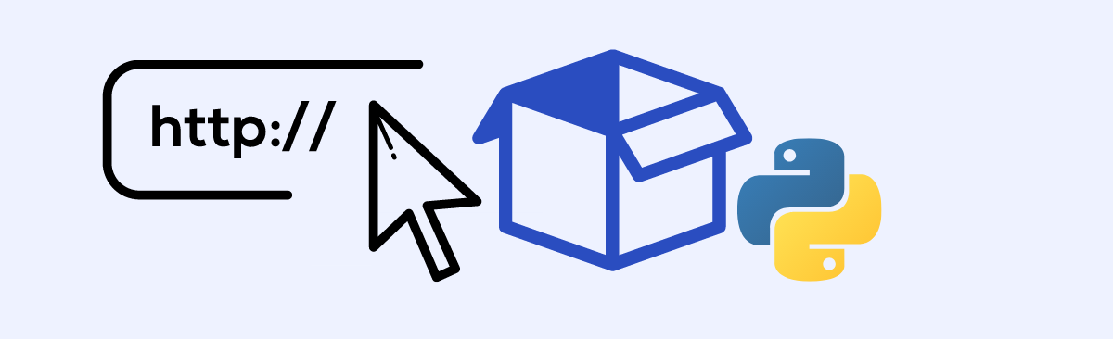
Interacting with web
Extracting data from websites & Automatic data collection
BeautifulSoup: parse HTML and XML to extract useful data
requests: for making HTTP requests to interact with APIs or download content

Slide 12


Interacting with data
Automating data extraction, cleaning, and transformation
Pandas: powerful tool for handling and processing structured data
NumPy: automates numerical and scientific computation

Slide 13
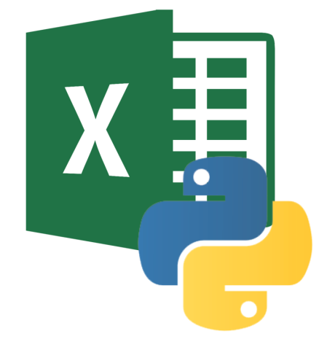
Interacting with Microsoft products
Python offers various libraries and tools for interacting with Microsoft products
Automating with PowerPoint tasks: create, edit, and modify PowerPoints presentations programmatically.
Python-pptx: allows you to create, edit, and modify PowerPoints presentations programmatically.
There is an advanced package but this libraries is ideal for client work
Automating Excel tasks: read, write, and manipulate Excel file
Openpyxl: used for reading and writing Excel files (.xlsx)
Pandas: used with Excel data for data structures and manipulation (read/write .xlsx or .csv files)

Slide 14
Python vs R
Feature | Python | R
Primary Use | General-purpose programming, data science, web development, automation | Primarily for statistical analysis, data science, research
Syntax | General-purpose, Object-Oriented | Domain-specific, functional
Ease of learning | Easy for beginners | Steeper learning curve for non-statistical tasks
Libraries for data science | Pandas, NumPy, Matplotlib, Seaborn, SciPy, Scikit-learn | Ggplot2, dplyr, tidyr, caret, shiny
Data visualization | Matplotlib, Seaborn, Plotly, Bokeh, Altair | Ggplot2, lattice, plotly, shiny
Data handling | Pandas | Dplyr, tidyr, and data.table
Integration with other tools | Excellent, with integrations for web framework, machine learning, databases | Great for statistical packages, but less for general-purpose integration
Automation | Highly suitable for automation | Limited automation capabilities compared to Python

Slide 15
What is pandas?
pandas is a fast, powerful, flexible and easy to use open source data analysis and manipulation tool, built on top of the Python programming language.
If you want to explore more, visit this link

Slide 16
Comparison chart for pandas vs tidyverse Python (pandas) and R (tidyverse) are highly capable when it comes to data manipulation and analysis
Feature | Pandas (Python) | R (tidyverse)
Data structure | DataFrame, Series | data.frame, tibble
Data import/export | Pd.read_csv() | read.csv()
Data filtering | .loc​[], .filter() | filter(), mutate()
Data aggregation | groupby(), .sum() | group_by(), summarize()​
Merging | .merge()​, .join() | left_join(), full_join()
Programming Paradigm | Object-Oriented | Functional (with Pipe operator)

Slide 17




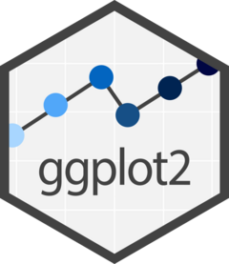
Data visualization
Python
Matplotlib: most commonly used visualization library in Python
Seaborn: provides higher-level interface, good for categorical and correlation visualization
Plotly: interactive plotting library that supports web-based, interactive visualization
R
ggplot2: most widely used visualization package in R
Shiny: used for building interactive web applications in R
plotly: same as the python, offers interactive plots for both web-based and dashboard

Slide 18
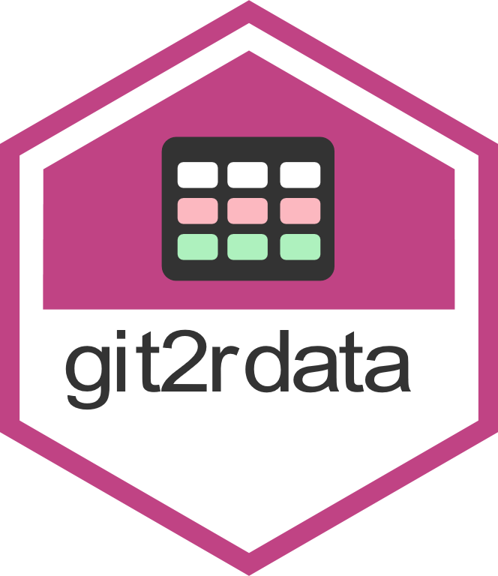

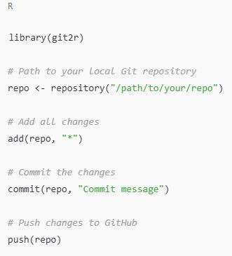
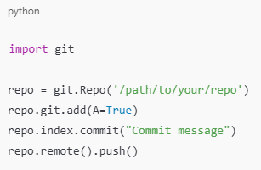
Push to GitHub from Python & R

Slide 19

How to download Python
Windows/macOS
Run the Installer – check the box that says "Add Python to PATH"
To confirm if it's installed – open cmd type python –version
Post-Installation - VS Code, Positron

Slide 20
Let's have fun!
Python_Automation

